Slide 1
Session 4 - Combating Discrimination Online (Part 2)

Slide 2
Outline – Session 4
Influencing attitudes through social communication
  Similarity of hate speech, dangerous language, and misinformation
  Identifying nodes of discriminatory language
  Counter messaging to reduce the influence of discriminatory content
  Encouraging the formation of social ties
  Challenge: quantifying the impact of campaigns
Group discussion
Group discussion sharing
Concluding statements / workshop summary

Slide 3
Influencing Attitudes Through Social Communication

Slide 4
Similarity of Hate Speech, Dangerous Language, and Misinformation
All based on information that creates false perceptions of the world and other groups
Hate speech and dangerous language differ
  Hate speech is can be said by anyone an focuses on statements
  Dangerous language said by influential people and feature calls to action (e.g. suggesting violence)

Slide 5
Identifying Nodes of Discriminatory Language
Influential sources of information are called “nodes” within a social network and can be…
  Originators (creators) of information
  Simply passing it on
Identifying nodes and reacting appropriately is essential
Once nodes are identified, what do we do?

Slide 6
Counter Messaging to Reduce the Influence of Discriminatory Content
Must implement some form of response
Persuasion is best since people resist being told how to think
Response can take many forms:
  Direct and public questioning
  Presentation of alternate viewpoints
  Legal action in extreme cases

Slide 7
Encouraging the Formation of Social Ties
Exposure is useful – research has shown that people accept other groups once they actually meet their members
How do we break down barriers using online communication?
How do we make people see others as equals to themselves?
Consider these questions as we go into the discussion session

Slide 8
Challenge: Quantifying the Impact of Campaigns
Difficulty of measuring success / impact of public communications campaigns
Challenge remains regardless of what broadcast medium is used
Particularly true in one-to-many push communications
Difficult to know if and how messages are received
Even if received, difficult to know if influential
?

Slide 9

Challenge: Quantifying the Impact of Campaigns
Social media provides opportunity for two-way communication
Engagement levels can be measured through basic metrics
  Retweets, likes, shares, comments, mentions, sentiment analysis

Slide 10

Challenge: Quantifying the Impact of Campaigns
Often then a problem of “preaching to the converted”
People most likely to pay attention to message are already in favour
Some opportunities to engage and persuade opponents online but rare
"No Hate Speech" Movement is likely to engage youths already opposed to hate speech

Slide 11

Challenge: Quantifying the Impact of Campaigns
Real target audience are people engaged in hate speech / discrimination
Perpetrators unlikely to be swayed by online messaging
HOWEVER
Supporters can be encouraged to make offline / "real-world" interventions

Slide 12
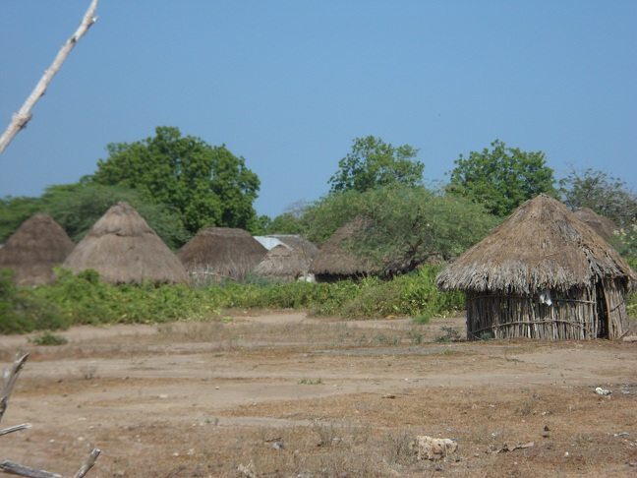
Challenge: Quantifying the Impact of Campaigns
Similar challenge in the Tana Delta area in Kenya
Overall project goal is to change attitudes towards rumours
Development of counter messages difficult without knowing impact
Most communication through SMS (text messages) and volunteers
Periodic public surveys will be used to gauge changes in attitudes and correlate these to counter messages

Slide 13
Group Discussion

Slide 14
Instructions
Divide into groups of five people (preferably the same as during Day 1)
Discuss as a group and take notes (45 minutes)
Select a spokesperson to share with the larger group
  Summarize highlights of group discussion (5 minutes each)

Slide 15
Discussion Questions
What issues of discrimination and hate speech most directly relate to your own work or the work of your department?
How much do you currently use social media and other online communications in your work?
How can social media and other online communications help you to work against hate speech and encourage non-discrimination?

Slide 16
Group Discussion Sharing

Slide 17
Concluding Statements / Workshop Summary

Slide 18
Putting Everything Together
Monitoring
+
Reporting
+
Direction
Counter Measures
+
Changing Attitudes
+
Building Social Ties
Measuring Progress
+
Improving Efforts

Slide 19
QUESTIONS?

